Slide 1

Electron Workshop
var trustMe = {
has: ["Beard", "Motorcycle"],
consumes: ["Bacon", "Caffeine"],
sometimesCanComputer: true
};
David Neal | reverentgeek.com | @reverentgeek
Notes:
I'M SO EXCITED!!!

Slide 2

Up Ahead
Create an App
Live Reload
Debug
IPC
Package

Slide 3


Slide 4


Slide 5
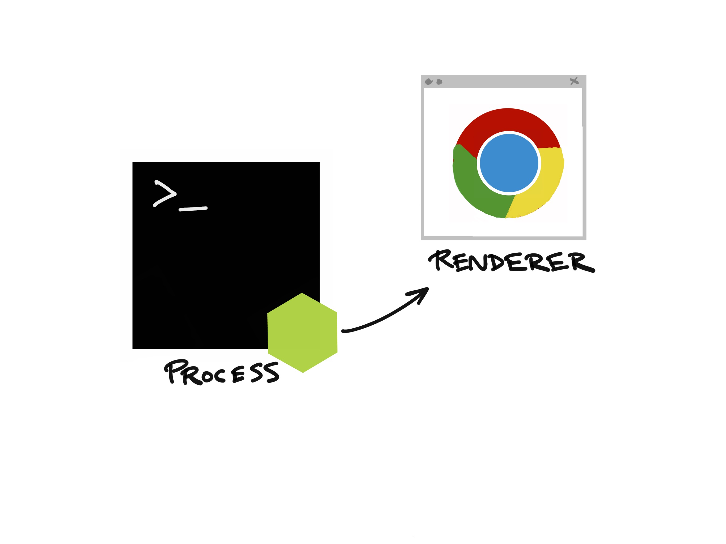
( main.js )
Notes:
Now I’d like to show you just how easy it is to get started with Electron…

Slide 6
( main.js )
Notes:
Now I’d like to show you just how easy it is to get started with Electron…

Slide 7
( index.html )
( main.js )
Notes:
Now I’d like to show you just how easy it is to get started with Electron…

Slide 8
( home.html )
( editor.html )
( settings.html )
( main.js )
Notes:
Now I’d like to show you just how easy it is to get started with Electron…

Slide 9
Let’s Get Started!
http://bit.ly/electron-workshop
- or –
https://github.com/reverentgeek/electron-workshop/wiki
Notes:
App: application lifecycle events, command-line arguments, system/user paths, launch browser windows (renderers)
Dialog: File Open/Save, Info and Error
Menu: Native app and context menus
Power monitor: monitor power state changes

Slide 10

Notes:
Run some experiments
Do like PayPay and give it a trial

Slide 12

Thank you!
David Neal
@ReverentGeek
david@reverentgeek.com
reverentgeek.com

